Slide 1
Recent Developments In RERA
By CA Chaitra Salankar
Date: Friday 03 May 2019

Slide 2
THANK YOU

Slide 3
Circulars and Orders

Slide 4
IMPORTANT CIRCULARS & ORDERS
Sr No | Particulars | Circular/Order
1 | Revocation of Registration of Project | Order No. 8/19, Dtd- 28-03-2019
2 | Approval of Association of Allottees for order under Section 7(3) of the Act | Order No. 7/19, Dtd- 08-02-2019
3 | Disclosure of Information regarding Project Professionals | Circular No. 21/2018 Dtd- 26-11-2018
4 | SOP for Handling Complaints on Non Registered Projects | Circular No. 22/2018 Dtd- 26-11-2018 Circular No. 23/2018 Dtd- 26-11-2018
5 | Procedure for referring complaints to MahaRERA Conciliation and Dispute Resolution Forum by MahaRERA or Adjudicating Officer of MahaRERA | Order No. 6/18, Dtd- 29-11-2018

Slide 5
IMPORTANT DEVELOPMENTS
Sr No | Particulars | Circular/Order
6 | Quality Assurance Certificate Form 2A | Order No. 8/18, Dtd- 26-11-2018
7 | Circular on Display of sanctioned plan layout plan at Project Site | Circular No. 20/2018 Dtd- 15-10-2018
8 | MahaRERA Divisional Office Address of Nagpur | Circular No. 16/2018 Dtd- 09-04-2018
9 | Land Owners/Investors having Area/Revenue Share in Real Estate Project to be treated as Promoter (landowner/investor) | Circular No. 12/2017 Dtd- 04-12-2017

Slide 6
MahaRERA shall only consider those complaints for revocation of project, when Association of Allottees is involved.
The association to provide :-
1. Declaration that no complaint is pending in any other forum
2. List of all stake holders- Promoter, Landowner, investor, Architects, CA certifying Form-3 and Form- 5, Banks etc.
Revocation of Registration of Project
Order No. 8/19, Dtd- 28-03-2019
Direction to be followed for Revocation of Project Registration

Slide 7
3. MahaRERA to constitute Designated Resolution Panel (DRP)
4. DRP to Shall prepare a Blueprint to complete the project.
5. Detailed Blueprint to consists of Financial Blueprint, Construction Blueprint
6. The existing project professionals namely Architect, Engineer, Chartered Accountant SHALL assist the panel
7. Blueprint to be completed in 4 months
Revocation of Registration of Project
Order No. 8/19, Dtd- 28-03-2019
Direction to be followed for Revocation of Project Registration

Slide 8
Section 7 Deals with Revocation of Registration on account of violations of the RERA.
Promoter due to genuine reasons is unable to comply with the provisions with the act, and desires to complete the project
The Association of Allottees can resolve and request MahaRERA to grant additional extension period for completion of the project.
Approval of Association of Allottees for order under Section 7(3) of the Act
Order No. 7/19, Dtd- 08-02-2019

Slide 9
To increase transparency, accountability and ease of information
Contact Details of Project Professionals is to be captured in the portal-Name, Mobile ,Email , Address, Rera Registration(for Agents)
Project Professionals :- Real Estate Agent, Contractors (Various), Architects (Form 1 and Form -4), Structural Engineer, Chartered Accountants (Form-3 and Form-5)
Effective from 01/12/2018
Disclosure of Information regarding Project Professionals
Circular No. 21/2018 Dtd- 26-11-2018

Slide 10
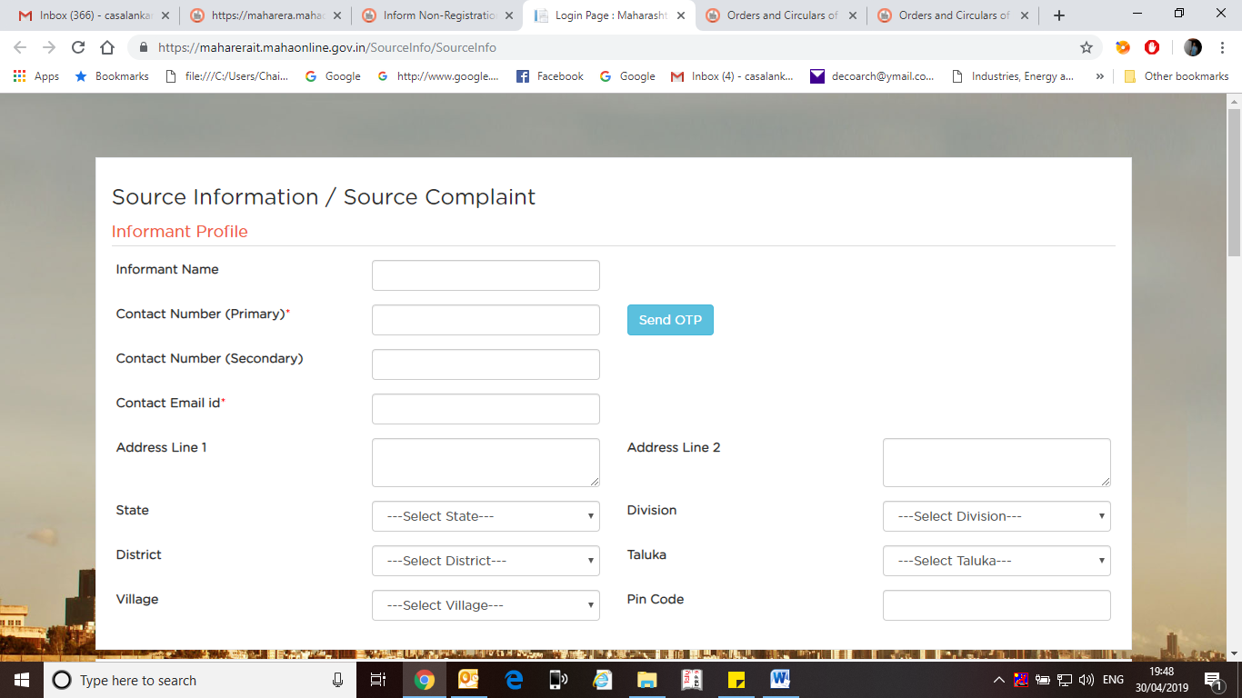
SOP for Handling Complaints on Non RegisteredProjects
Circular No. 22/2018 Dtd- 26-11-2018
Circular No. 23/2018 Dtd- 26-11-2018

Slide 11
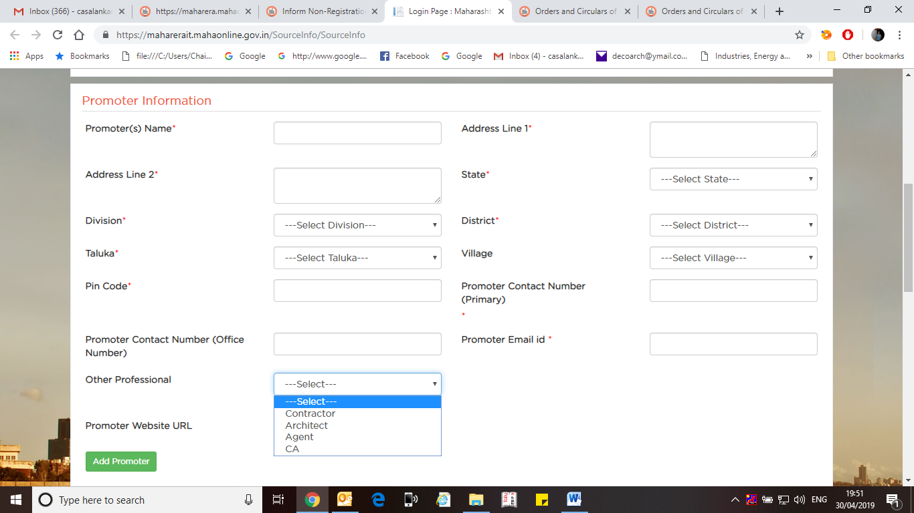
SOP for Handling Complaints on Non RegisteredProjects
Circular No. 22/2018 Dtd- 26-11-2018
Circular No. 23/2018 Dtd- 26-11-2018

Slide 12
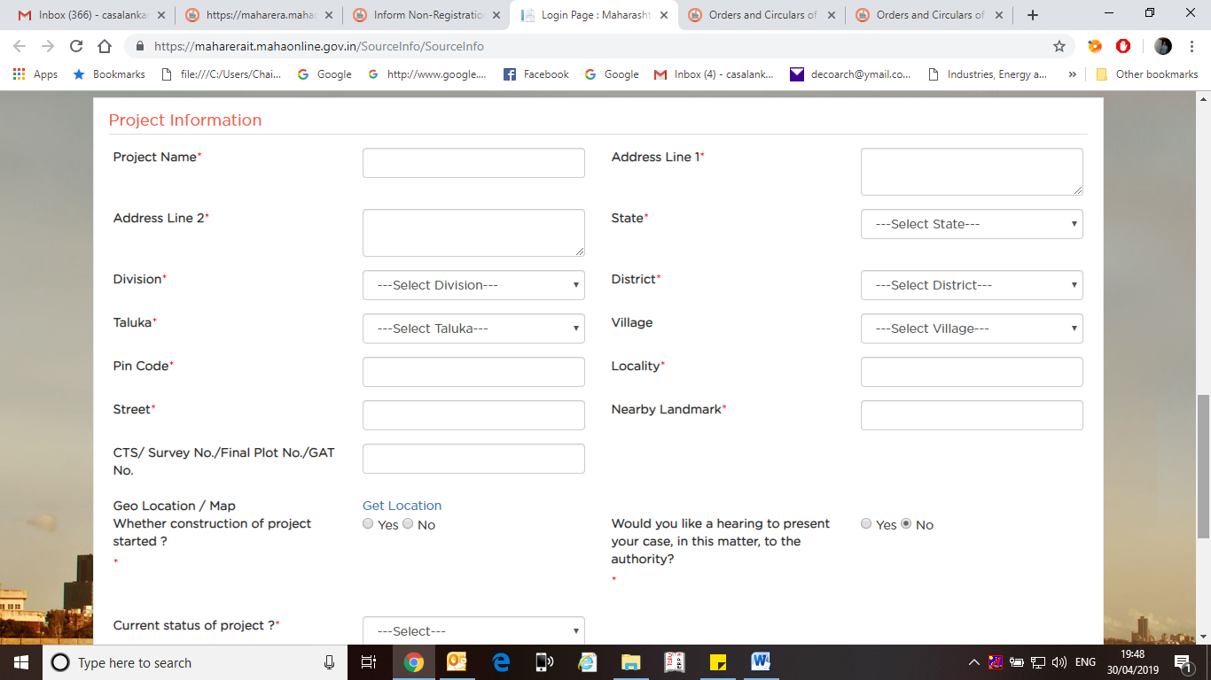
SOP for Handling Complaints on Non RegisteredProjects
Circular No. 22/2018 Dtd- 26-11-2018
Circular No. 23/2018 Dtd- 26-11-2018

Slide 13
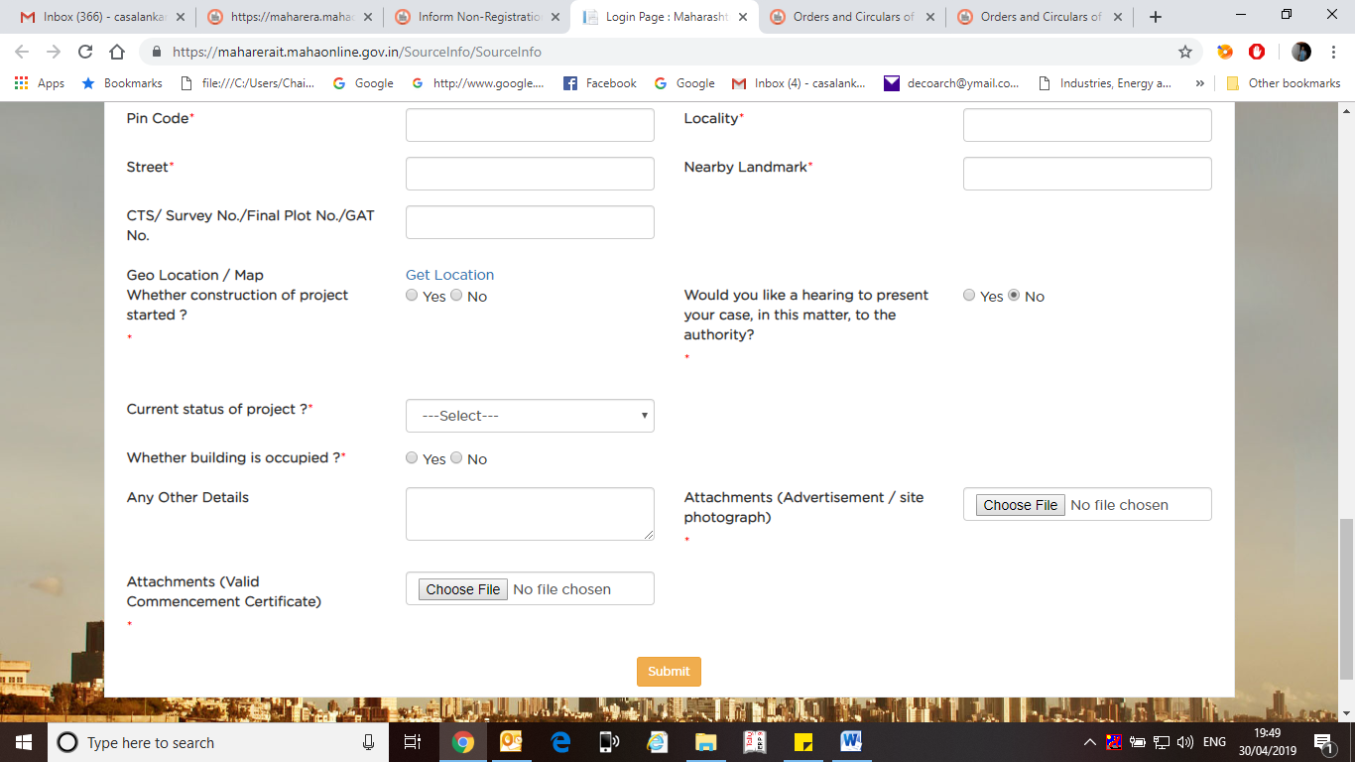
SOP for Handling Complaints on Non RegisteredProjects
Circular No. 22/2018 Dtd- 26-11-2018
Circular No. 23/2018 Dtd- 26-11-2018

Slide 14
To facilitate alternate dispute resolution, where both parties agree
MahaRERA can send the complaint to Conciliation and Dispute Resolution Forum
The website for the application is:- https://mahareraconciliation.mahaonline.gov.in
Procedure for referring complaints to MahaRERA Conciliation and Dispute Resolution Forum by MahaRERA or Adjudicating Officer of MahaRERA
Order No. 6/18, Dtd- 29-11-2018

Slide 15
New Certificate- Form 2A- From Engineer who supervises the work.
Applicable from new registration from 1.12.2018
To be submitted quarterly
Quality Assurance Certificate Form 2A
Order No. 8/18, Dtd- 26-11-2018

Slide 16
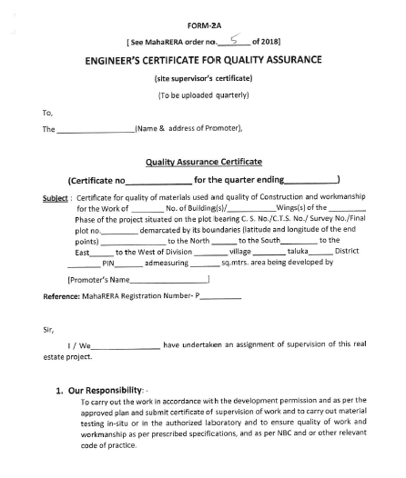
Quality Assurance Certificate Form 2A
Order No. 8/18, Dtd- 26-11-2018

Slide 17
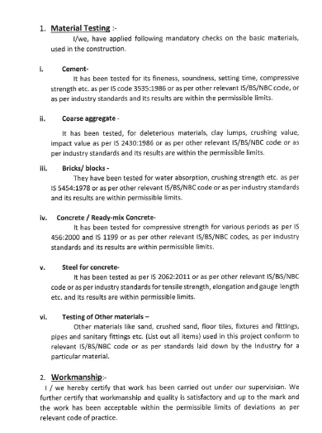
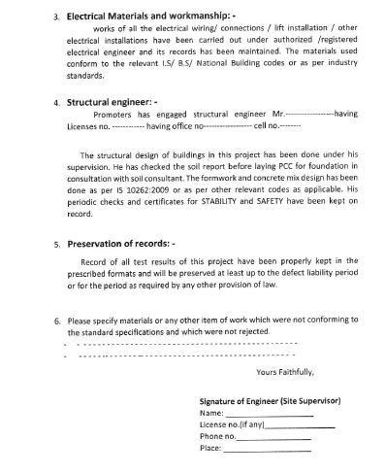
Quality Assurance Certificate Form 2A
Order No. 8/18, Dtd- 26-11-2018

Slide 18
The Title of circular is self explanatory.
RERA already mandated display of Sanctioned Maps
But the circular was introduced on an observation made by Supreme Court in Ferani Hotels Pvt. Ltd. V / s State Information Commissioner Greater
Mumbai & others
Therefore a non compliance to this is viewed seriously and action may be initiated accordingly without any leniency.
Circular on Display of sanctioned plan layout plan at Project Site
Circular No. 20/2018 Dtd- 15-10-2018

Slide 19
NAGPUR DIVISION OFFICE
Deputy Secretary cum Head MahaRERA Nagpur
Administrative Building No.1, 1st Floor, Adjacent to Udyog Bhavan, Civil Lines Nagpur - 440001.
Tel. No.: 0712 2551400
MahaRERA Divisional Office Address of Nagpur
Circular No. 16/2018 Dtd- 09-04-2018

Slide 20
For the benefit of the consumers it is necessary to distinguish and / or identify whether such Promoter is the land owner, investor or is actually obtaining the building permissions for carrying out the construction and is in fact carrying out construction.
Such individual/organisations who are interested in project as Land Owner/ Investors having Area/Revenue Share to be treated as Promoter (landowner/investor)
Land Owners/Investors having Area/Revenue Share in Real Estate Project to be treated as Promoter (landowner/investor)
Circular No. 12/2017 Dtd- 04-12-2017

Slide 21
Liabilities of such land owner Promoter or investor Promoter shall be as co-terminus with the written agreement / arrangement governing their rights in the real estate project, But
For the purpose of withdrawal from the designated bank account of a real estate project, the obligations and liabilities of all such Promoters shall be at par with each other.
A copy of agreement to be uploaded for public viewing
Land Owners/Investors having Area/Revenue Share in Real Estate Project to be treated as Promoter (landowner/investor)
Circular No. 12/2017 Dtd- 04-12-2017

Slide 22
Such land owner promoter and investor promoter to submit declaration in Form B (Affidavit)
Such promoter who is entitled to share of total area developed, should open a separate bank account for deposit of 70 %of the sale proceeds.
Land Owners/Investors having Area/Revenue Share in Real Estate Project to be treated as Promoter (landowner/investor)
Circular No. 12/2017 Dtd- 04-12-2017

Slide 23
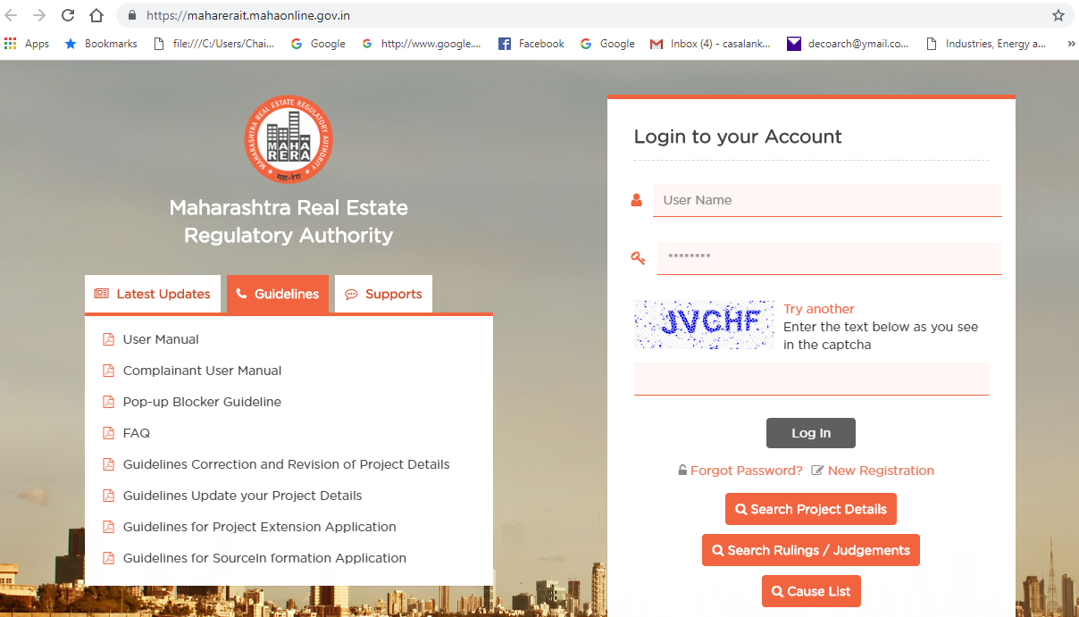
MAHARERA GUIDELINES

Slide 24
Some Cases

Slide 25
Simmi Sikka V/s Emmar MGF Land Limited
Authority
Haryana Rera
Question
If Advertisement of Project is made after completion certificate, would the project would be liable for registration under Rera
Held
The Project where the promoter intends to advertise, market, book, sale or offer to sale or invite persons to purchase in manner any plot, apartment or building after completion of the project shall be in violation of section 3(1) and section 4(1) of the act. The new project is to be registered by the promoter irrespective of the fact whether it is to be advertised , marketed etc. before completion of project or post completion of project

Slide 26
Prasad Bhatlawande V/s Rajmudra Agro Developers Pvt Ltd
Authority
MahaRera
Brief Facts
The complainant entered into agreement to purchase the Row Houses from the Developer
2 Agreements were entered. 1st for sale of plot and 2nd for construction on agricultural plot and there exists forest on site.
Held
The subject plots are the agricultural land and till date there is no permissions granted by the Competent Authority for development of the said land, such NA order and therefore the MahaRERA is of the view that it is not o project as defined u/s 2 (zn) of the RERA ACT. Hence same cannot be registered u/s 3 of the RERA ACT

Slide 27
Avinash Saraf, Neha Duggar Saraf vs Runwal Homes Pvt. Ltd.
Authority
MahaRERA
Brief Facts
The present complaint was filed seeking refund of the sale consideration along with interest and compensation for the delay in project completion. This case decides many contentious issues, faced commonly by other home buyers.
Held
Firstly, it was decided that in case of delay there is a recurring cause of action and buyer can file the case anytime during the continuation of delay. Secondly, the Authority held that Section 79 of RER Act bars jurisdiction of all civil courts, therefore the Authority has jurisdiction of deciding agreement under MOFA as well. Thirdly, Section 71(1) makes it clear that Section 12, 14, 18 & 19 applies retroactively. Fourth, for calculating delay, promised date of delivery as provided in the agreement has to be seen and not the date unilaterally decided by the builder at the time of RERA registration. Fifth, if the transaction is cancelled due to builder's default, then no charges can be deducted out of the amount advanced by the buyer. Sixth, interest awarded under the Act cannot go beyond those prescribed under the Act and respective rules.

Slide 28
Secretary, MahaRERA Versus Piramal Group- Glider Buildcon Realtors.
Authority
MahaRERA
Brief Facts
The promoter published a 2 page advertisement in a newspaper.
On the 1st page there was no MahaRERA registration No at all. The registration number is mentioned on the second page in very small font/ print. Further the MahaRERA registration No is not accompanied by the website of MahaRERA
Held
Provisions of RERA were violated and promoter shall be liable to a penalty which may extend upto five per cent of the estimated cost of the project. Promoter accepted the mistake and since the mistake was unintentional promoter directed to pay fine of Rs 50.00 Lacs

Slide 29
Important Rulings by MahaRERA
Construction of additional floors without the consent of 2/3rd of the allottees.
- The developer has launched project with 7 floors and sold more than 50% of the apartments up till 7th floor. The information which developer uploaded shows that the developer was going to construct 10 floors. Subsequently, the developer started to construct additional 2 floors above the 7th floor without taking the consent of the 2/3rd of the allottees. It was evident that due to developer’s intention to construct the additional the project was getting delayed.
- The developer argued that the allottee has signed the agreement which has a clause that the developer can make alterations and additions and such addition of 2 floors falls under the category of addition. The authority opined that the clauses of the agreement cannot override the provisions of section 14 (2) of the act, which requires the developer to take the previous written consent of 2/3rd of allottees before making any alternations in the sanctioned plans, layout, specifications of the building and common areas. Thus, the developer is restrained from construction of the additional 2 floors. The allottees will be compensated with an amount of INR 25000 each

Slide 30
Important Rulings by MahaRERA
Repercussions on failure to form a society.
The developer had failed to form a cooperative society after 7 months of receiving occupation certificate and handing over the possession of the premises to the allottees.
The developer argued by saying that he has not received any names for initiating the process of formation of the society.
The authority has ordered that since sufficient time has elapsed since the receipt of Occupation certificate and handing over the possession developer to form a society without granting any additional time and the allottees are also directed to cooperate peacefully to enable the developer to complete the procedure of formation of the society at the earliest.

Slide 31
Important Rulings by MahaRERA
Whether the developer is entitled to refund booking amount in case of unilateral cancellation by complainant in absence of agreement to sale
a.The Authority inspected the Developers online registration and found all permissions, draft agreement in place. Thus they held that the developer is not in violation of section 7,12, and 13 of RERA Act.
b.Also, as the amount paid was less than 10%, developer was not required to execute agreement to sale
c.As a result, the complainant’s plea for refund of booking amount with interest was dismissed..

Slide 32
WHERE TO GET HELP
1. MAHARERA WEBSITE
2.MAHARERA OFFICE
3.CA CHAITRA SALANKAR
C A SALANKAR AND ASSOCIATES
Mob :+91 98609 78333
Off :0712- 2294173
Email:chaitra@casalankar.com

Slide 33

Arise, awake and Stop not till the Goal is Reached

Slide 34
THANK YOU ONCE AGAIN

